Slide 1
I was
determined
to live a better life
Notes:
My mum started a hair salon in Singapore
because the money is better when I was XX.
She worked very long hours.
I was determined to live a better family life.

Slide 2
I thought I was
contented
Notes:
My mum started a hair salon in Singapore
because the money is better when I was XX.
She worked very long hours.
I was determined to live a better family life.

Slide 3
I started my journey
shop.com
Notes:
A girl friend shared about shop.com w me 4 years ago. I was one of the first 100 people to join the business in Singapore ….
It was my shopping account to spend my hubby’s $$$. I use to buy PENTAXYL in pairs!!! **
My journey really started w my first CONVENTION in MAY2014 AUSTRALIA
I told my husband we were taking a holiday and i brought my 18 year old daughter w me… she encouraged me to do this seriously.

Slide 4
2014 Australia***
2015 Greensboro
2016 Greensboro
2017 Miami
2017 Greensboro
2018 Miami
GMTSS
learning
from event to event
growing
Notes:
A girl friend shared about shop.com w me 4 years ago. I was one of the first 100 people to join the business in Singapore ….
It was my shopping account to spend my hubby’s $$$. I use to buy PENTAXYL in pairs!!! **
My journey really started w my first CONVENTION in MAY2014 AUSTRALIA.
I told my husband we were taking a holiday and i brought my 18 year old daughter w me… she encouraged me to do this seriously.

Slide 5
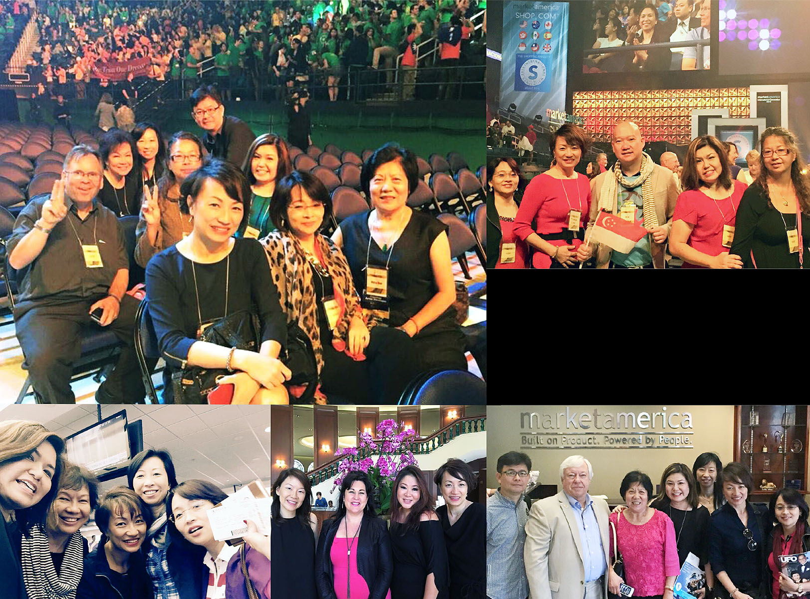
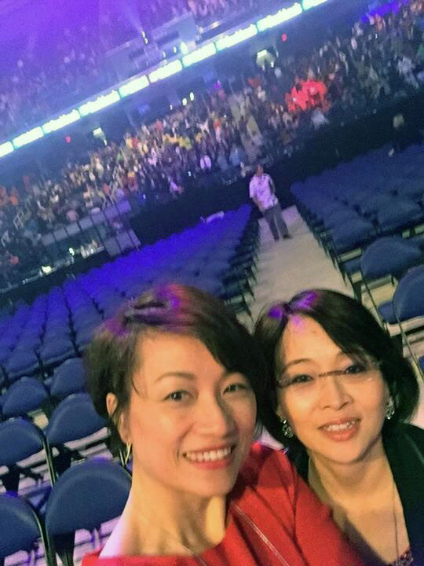
Growing from event to event

Slide 6
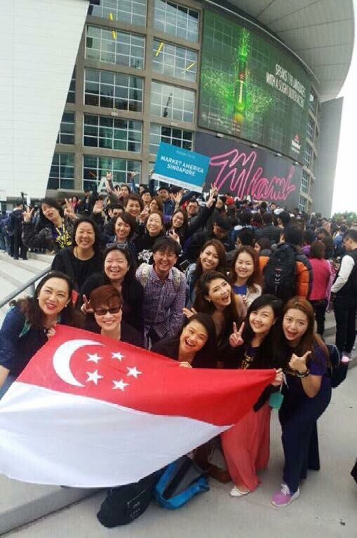
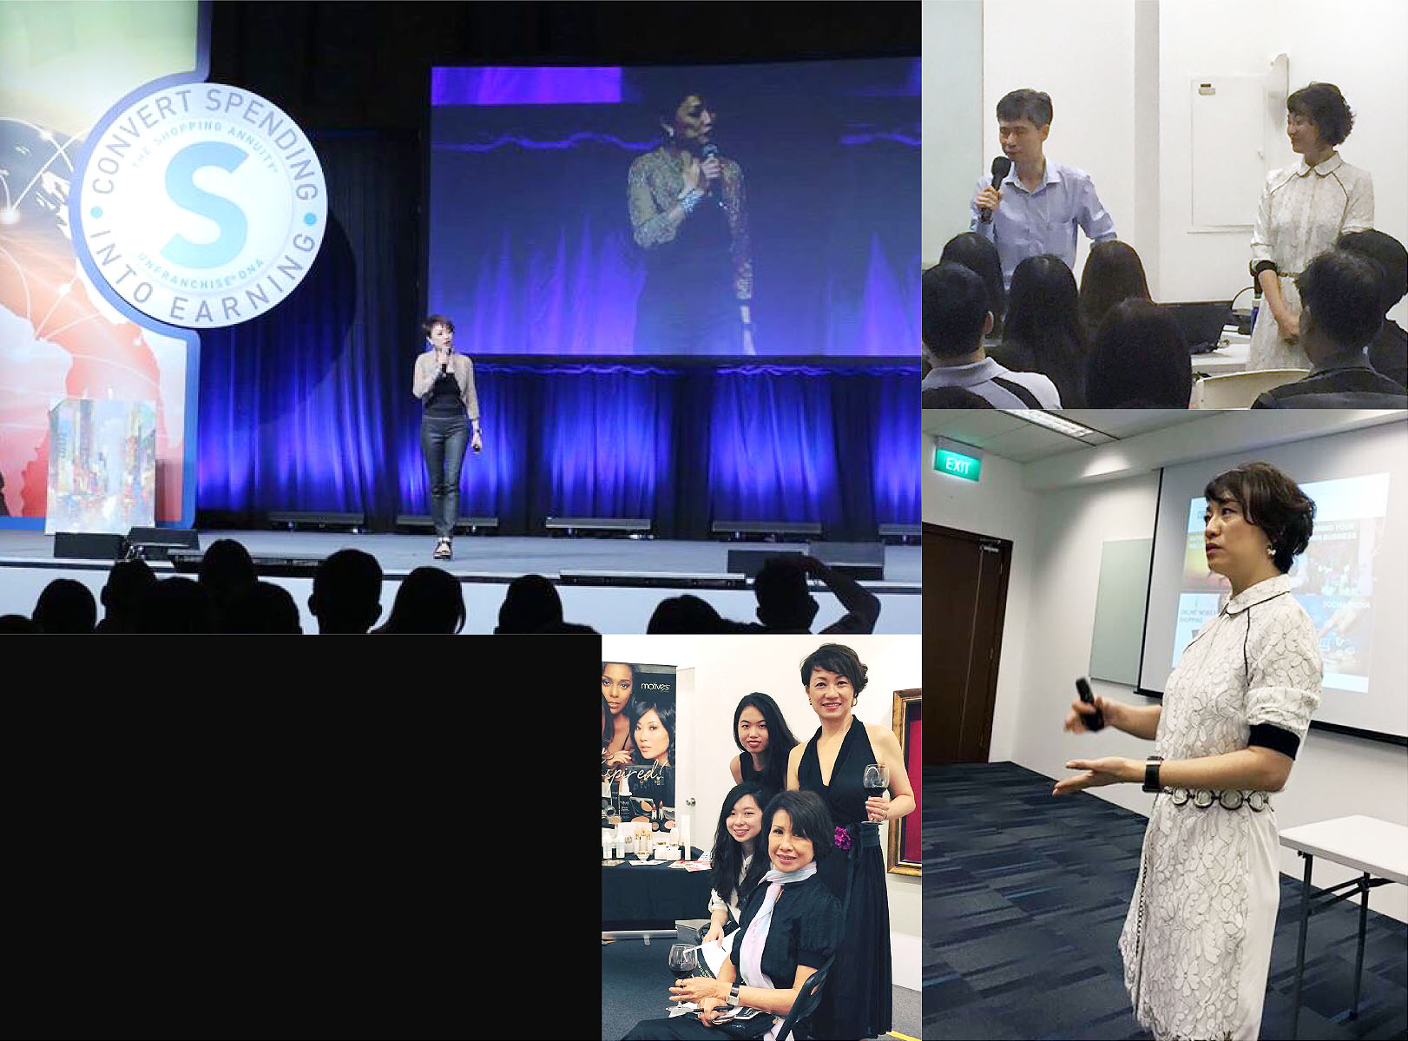
Growing from event to event

Slide 7
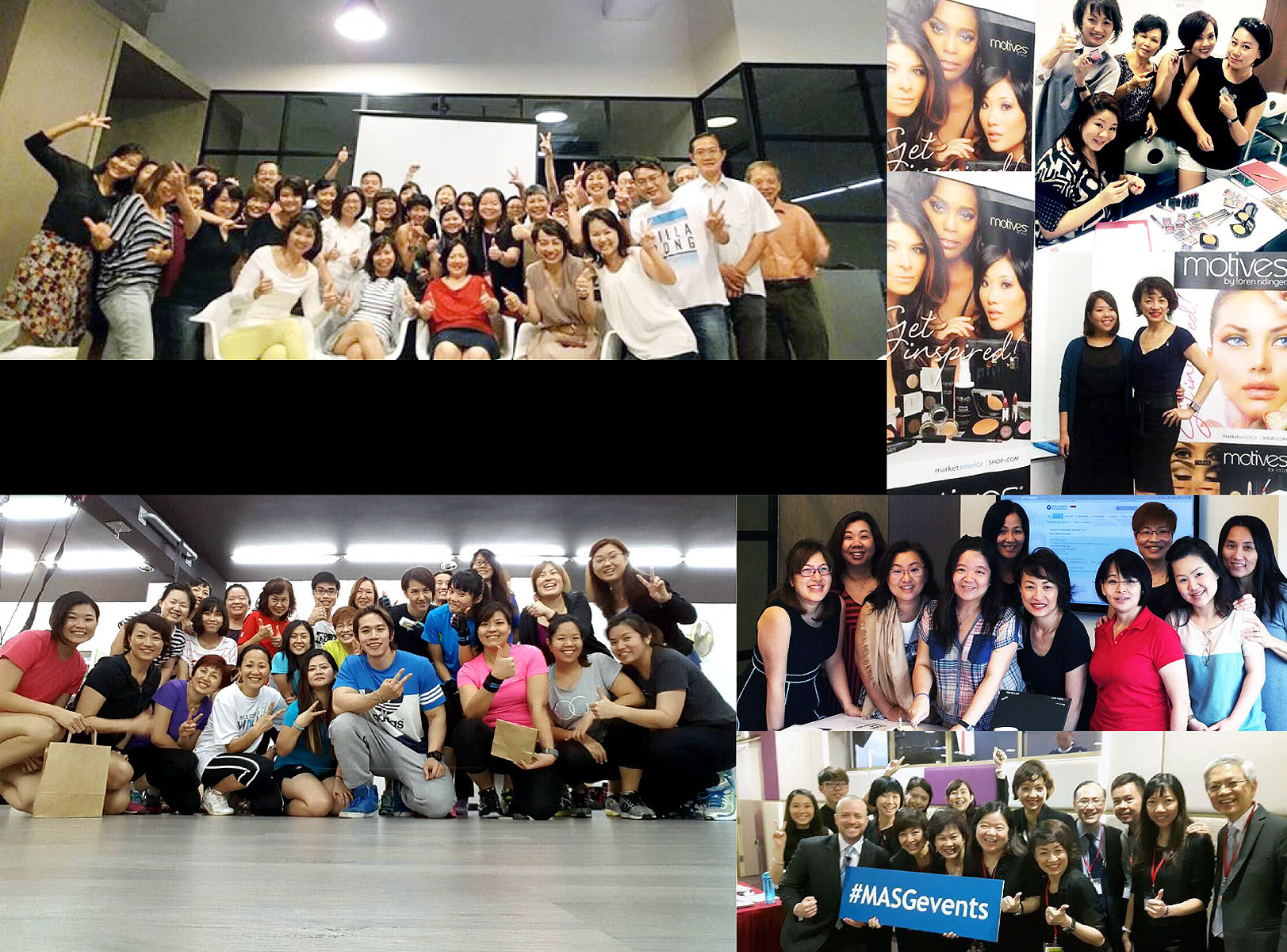
Growing from event to event

Slide 8
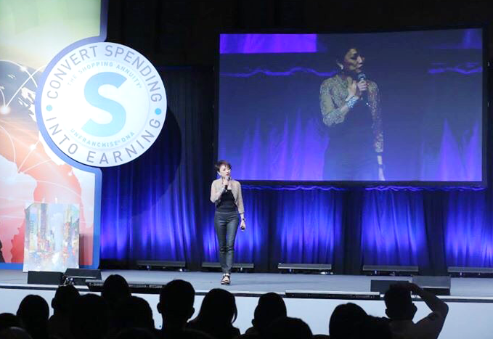
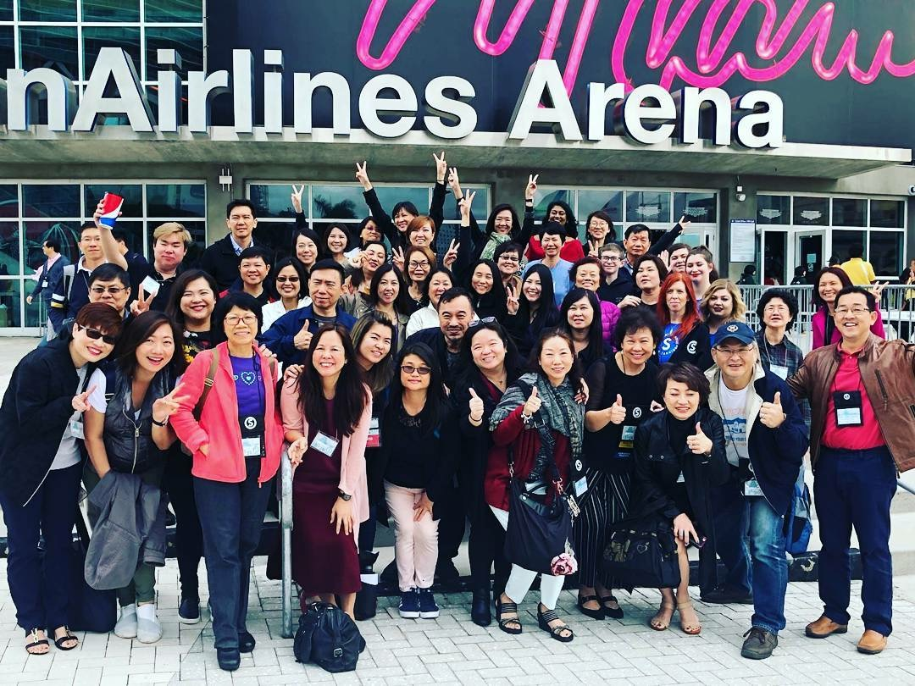
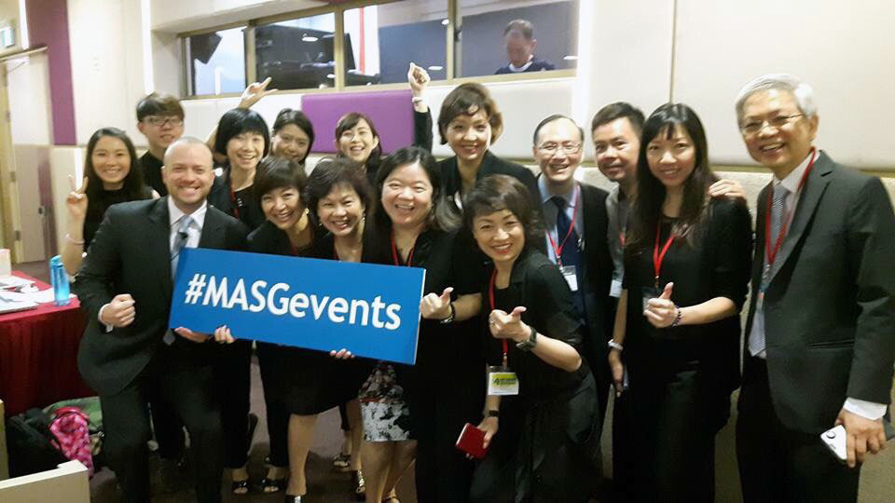
Growing from event to event

Slide 9
my rough start
rediscovering
myself
Notes:
Before u become a great leader… you have to be a good student.
The desire to excel became stronger as i gain confidence in the system, the company and the products.
We are a truly innovative, progressive & hardworking company... and we own a part of this future business.

Slide 10
IAM
coachable
Notes:
You have to be a good student… before u can become a great leader…
The desire to excel became stronger as i gain confidence in the system, the company and the product.
We are a truly innovative, progressive & hardworking company... and we own a part of this future business.

Slide 11
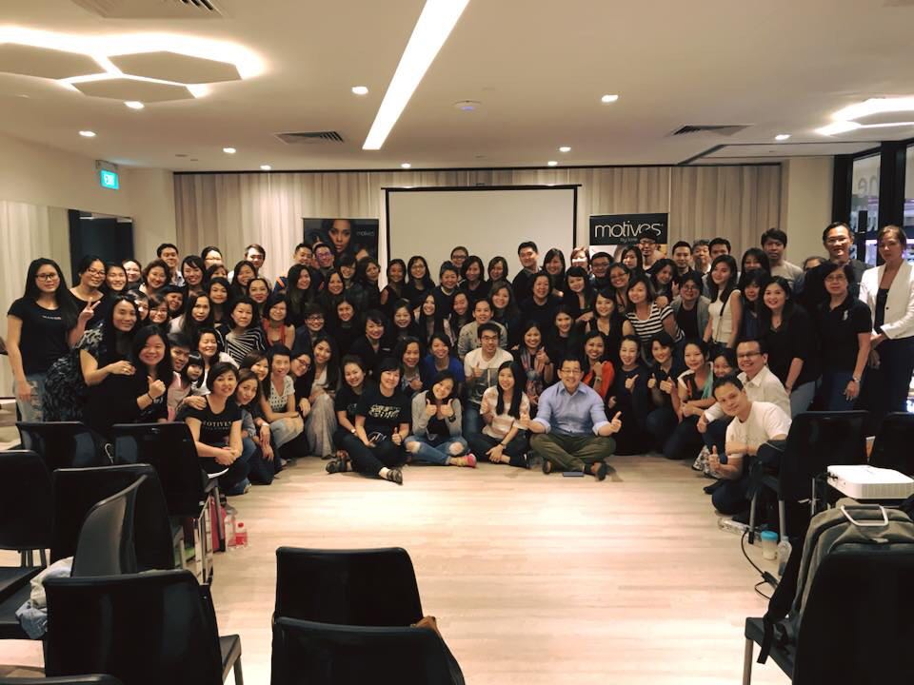
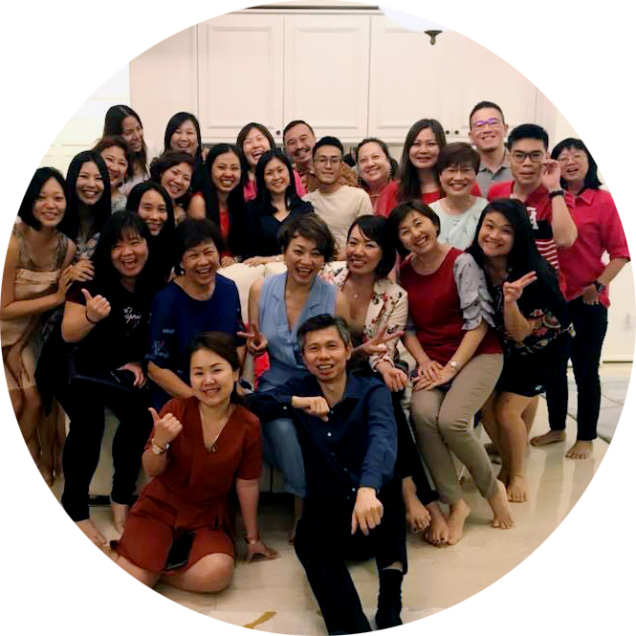
never alone
IAM
Notes:
Its humbling to be able to walk this journey w so many like-minded people… who believe...
We all have our limitations and challenges But when we put our strengths together… we can

Slide 12
Lead
...with your heart
Notes:
You have to be a good student… before u can become a great leader…

Slide 13
It is
empowering
Notes:
Its empowering...
the income gave me and my family security & stability
I can now do what I always wanted to do
We are a truly innovative,
progressive & hardworking company
... and we own a part of this future business.

Slide 14
I believe
I can
I have to succeed so that others can realise their dreams – JR
Notes:
My humble upbringing prepared me...
Thankyou mummy for always believing that i am very special
... and shop.com for paving the way to live my dreams
and through me... help change the lives of many
SO CAN U!
SEE U AT THE TOP!

